Slide 1
CE 651:Road Safety Engineering
Road Safety Audit
Submitted By
Group - 1

Slide 2
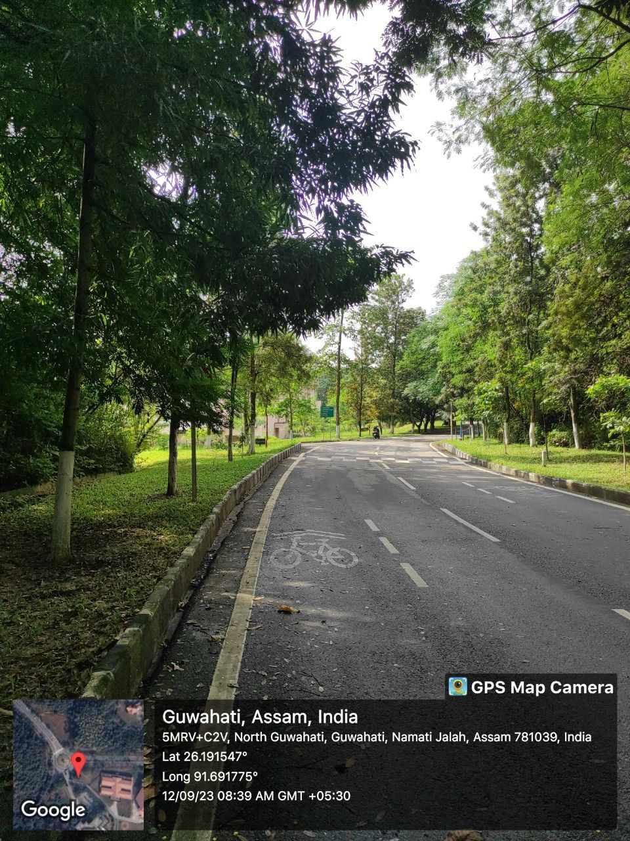
Location No.1
Observation – Hump sign for Speed Breaker is provided before crossing with other road, but it is not at all visible because of leaves of trees. Also no sign for side road ahead is given.
Risk – High
Priority – Essential
Suggestions – Low hanging branches of trees and shrubs needs to be cut near traffic signs for clear visibility of traffic signs. Provide ‘Side Road Left’ sign.

Slide 3
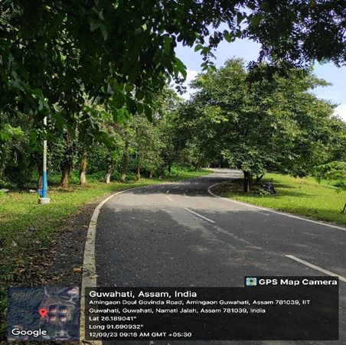
Location No.2
Observation – There is a “Right Reverse Bend” curve ahead, but no sign is provided for it.
Risk – High
Priority – Highly Essential
Suggestions – "Right Reverse Bend” sign must be provided.

Slide 4
Location No.2
Observation – Also, at this location because of sharp curve to avoid overtaking, Solid line marking must be provided instead of broken line.
Risk – High
Priority – Highly Essential
Suggestions – Either Solid line marking or ‘No Overtaking Sign’ needs to be provided to avoid any accident here at sharp curve.

Slide 5
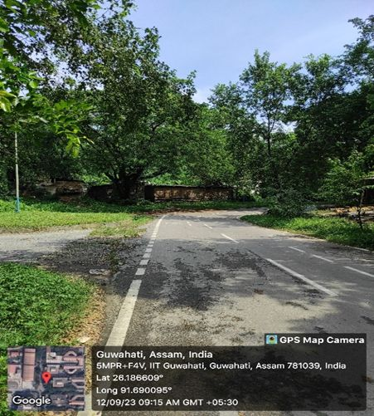
Location No.3
Observation – There is a sharp right hand curve ahead but no ‘Right Hand Curve’ sign is provided to guide vehicles.
Risk – High
Priority – Highly Essential
Suggestions – ‘Right Hand Curve’ sign must be provided.

Slide 6
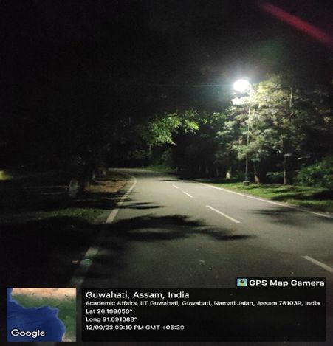
Location No.4
Observation – At this curve no Chevron signs are provided which can warn the vehicles about a change in direction during nighttime.
Risk – High
Priority – Highly Essential
Suggestions – ‘Chevron Signs’ must be provided.

Slide 7
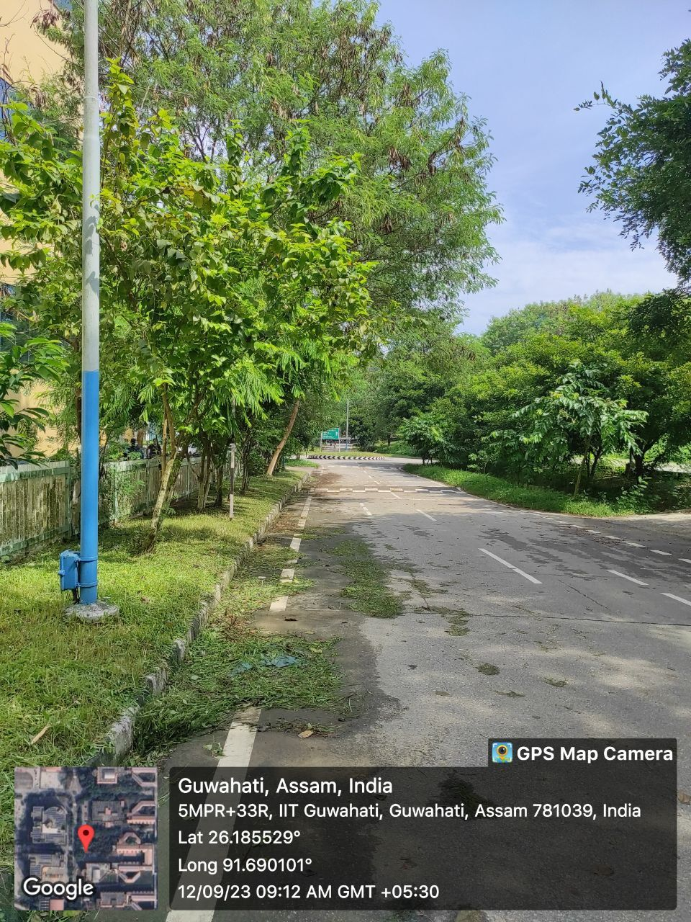
Location No.5
Observation – There is a Roundabout ahead but no sign is provided before it to warn the road users.
Risk – High
Priority – Highly Essential
Suggestions – Provide the ‘Roundabout’ sign to warn the road users about the roundabout ahead.

Slide 8
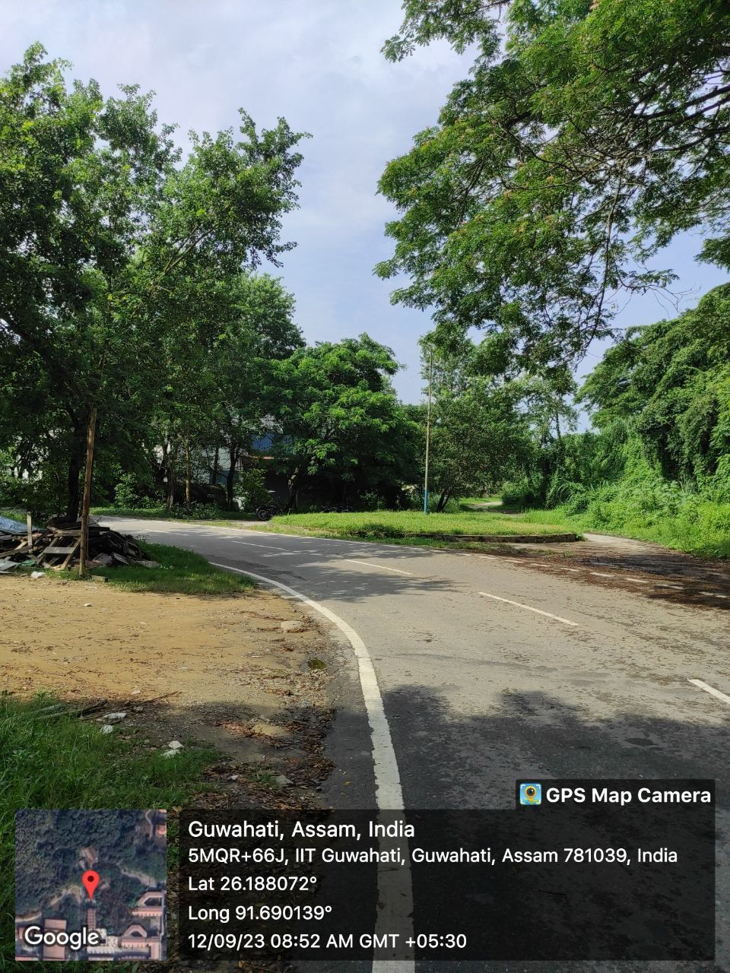
Location No.6
Observation – There is a Roundabout ahead but it is not well maintained. No Chevron signs are provided over it to warn the road user during nighttime.
Risk – High
Priority – Highly Essential
Suggestions – Maybe this ‘Roundabout’ is not in much use, so it is better to either maintain it by providing proper signs or it should be closed by providing the ‘Roadway Indicator’ for the left hand curve only, to avoid any accident.

Slide 9
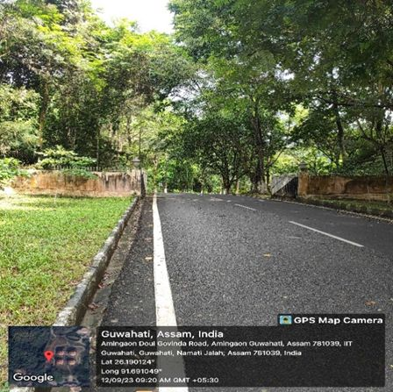
Location No.7
Observation – There is a gate ahead which comes under objects adjacent to carriageway which can lead to road crashes if vehicle runoff the roadway, as here no marking is provided on the walls of the gate adjacent to edges of the road.
Risk – Low
Priority – Essential
Suggestions – Provide alternate Black and White solid lines on the wall of the gate near both edges of carriageway.

Slide 10
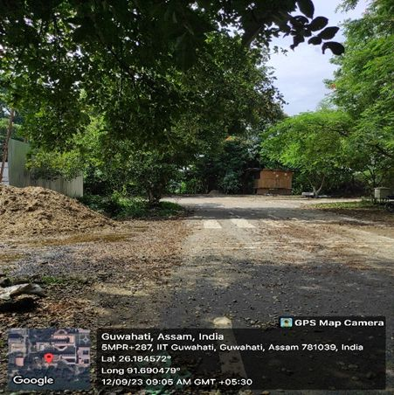
Location No.8
Observation – Construction work is going on at this location that can cause road to be slippery, but no proper sign is provided to warn vehicles to Go slow.
Risk – Medium
Priority – Essential
Suggestions – “Construction work ahead” / “Go slow” sign can be provided to avoid any accident.

Slide 11
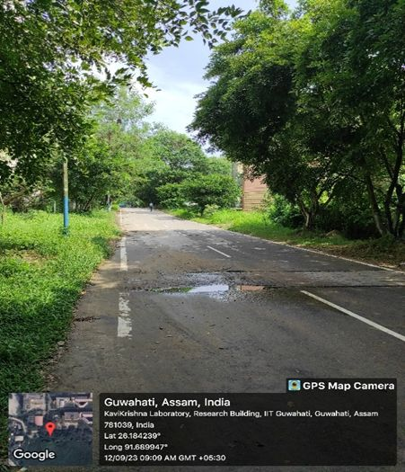
Location No.9
Observation – A pothole is formed on the road at this location because of not having a proper side drain which causes the water to stay here and makes the road slippery.
Risk – High
Priority – Highly Essential
Suggestions – The pothole needs to be filled as soon as possible to avoid any accident especially related to pedestrian and cyclist.

Slide 12
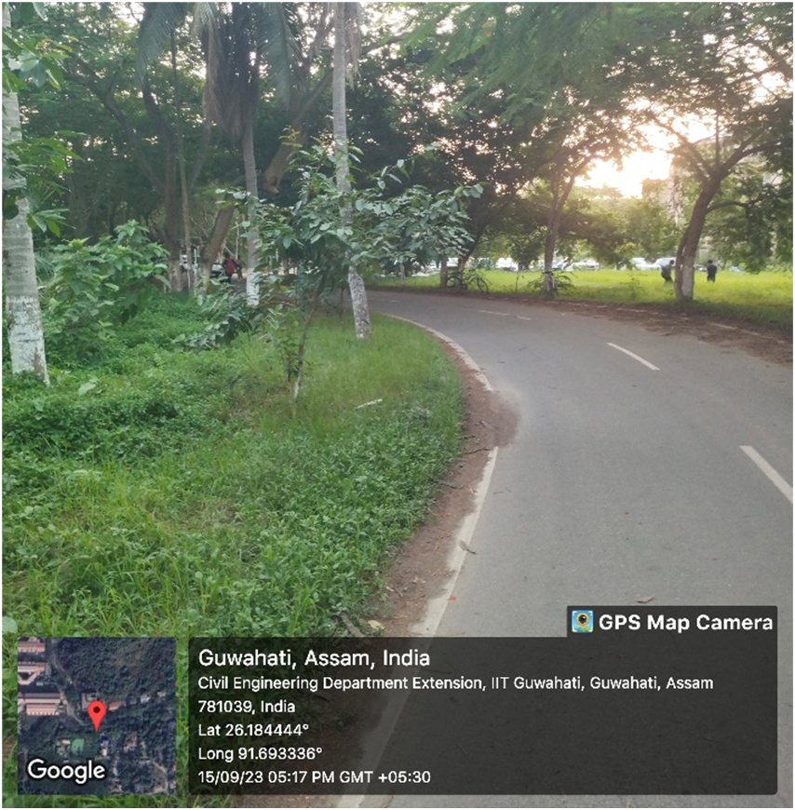
Location No.10
Observation – There is a sharp s-curve ahead, but no sign is provided.
Risk – High
Priority – Highly Essential
Suggestions – Sign board of S-curve should be there.

Slide 13
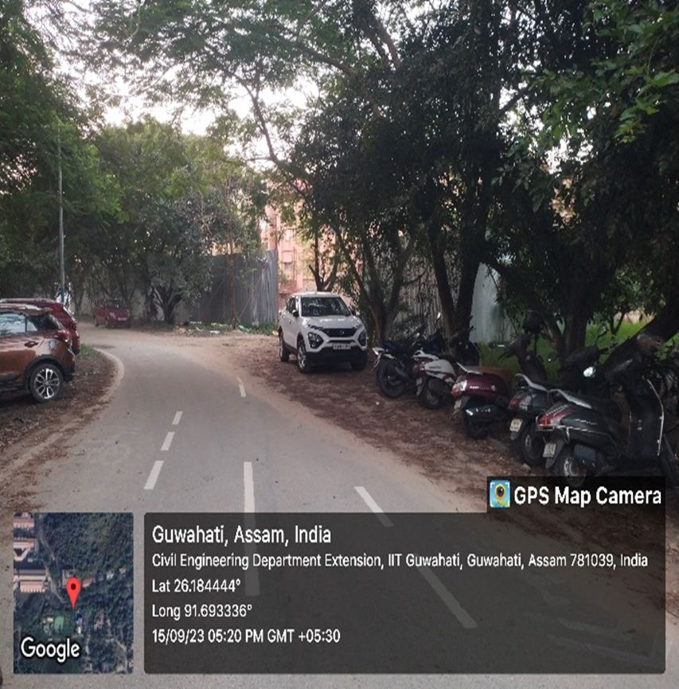
Location No.11
Observation – Here road space is occupied by vehicles, to avoid this kerb should be constructed. Also construction work is going on at that location, vehicles should be warned to go slow.
Risk – Medium
Priority – Essential
Suggestions – Kerb construction and construction work ahead or “go slow” sign can be provided .

Slide 14
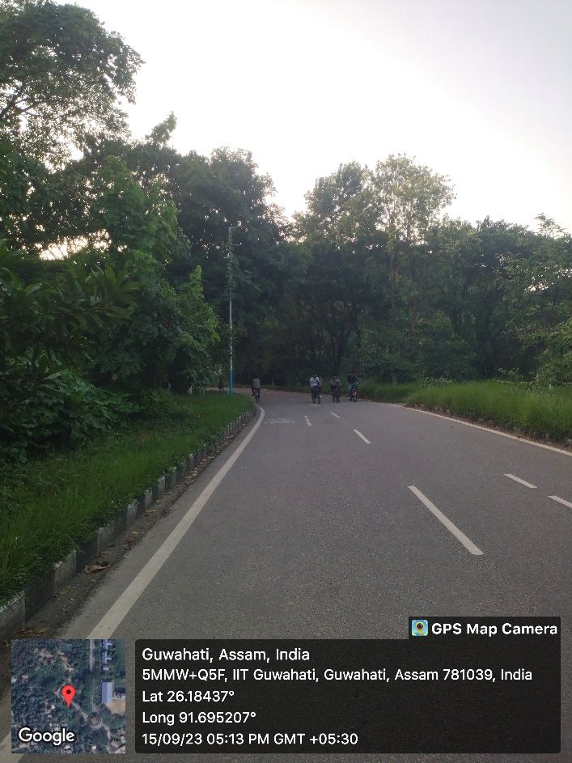
Location No.12
Observation – No sign is there for the sharp turn.
Risk – High
Priority – Essential
Suggestions – Some sign board or delineator should be there.

Slide 15
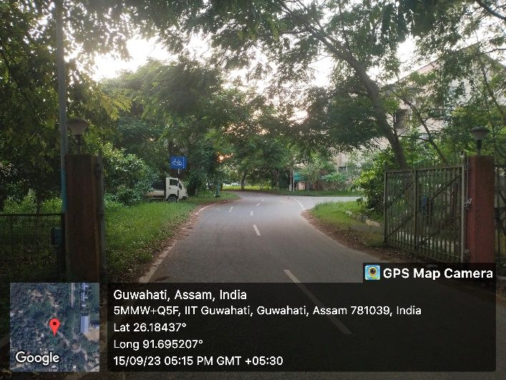
Location No.13
Observation – Vehicle coming from the other way are not visible.
Risk – High
Priority – Highly Essential
Suggestions – We should put convex mirror there.

Slide 16
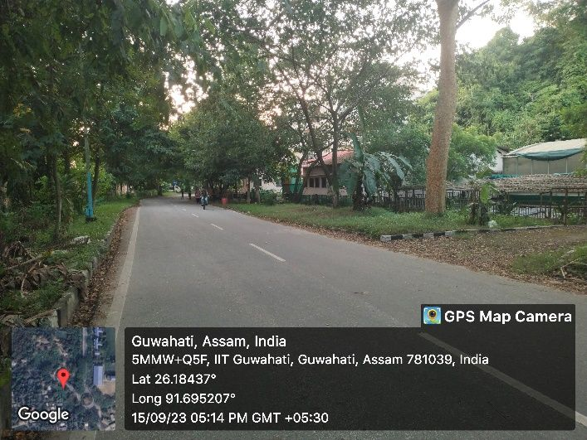
Location No.14
Observation – Here at the right side of road kerb is there but it is fully covered by grass, soil and mud.
Risk – Low
Priority – Essential
Suggestions – The kerb should be clean and clearly visible.

Slide 17
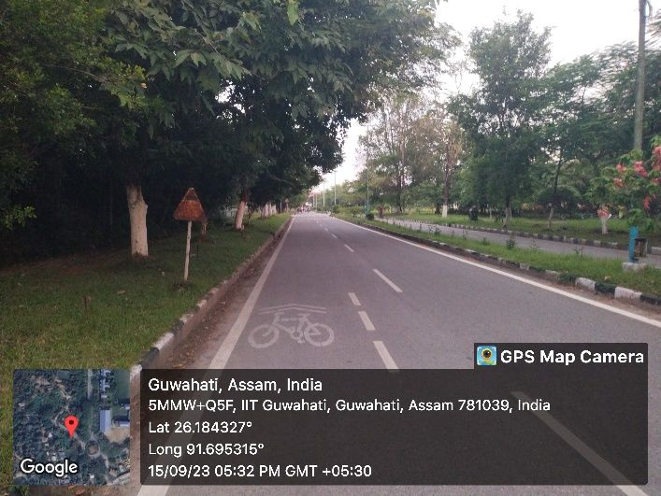
Location No.15
Observation – Road sign is not visible some time due to rust and dust and sometime due to branches of trees.
Risk – High
Priority – Essential
Suggestions – Periodic maintenance should be there, for these kind of problems.

Slide 18
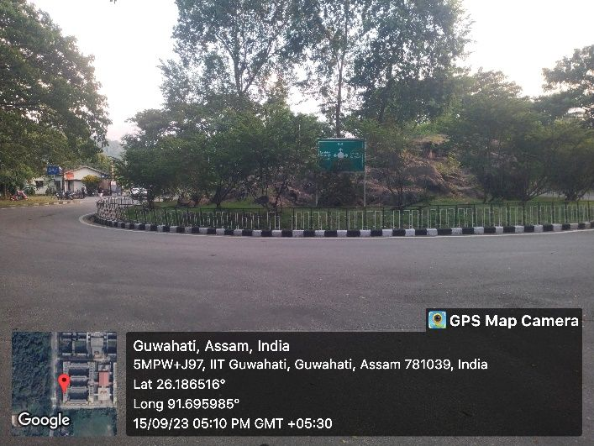
Location No.16
Observation – Keep left sign should be there, the weaving section width is also small there.
Risk – High
Priority – Essential
Suggestions – Keep left sign should be there on that round about.

Slide 19
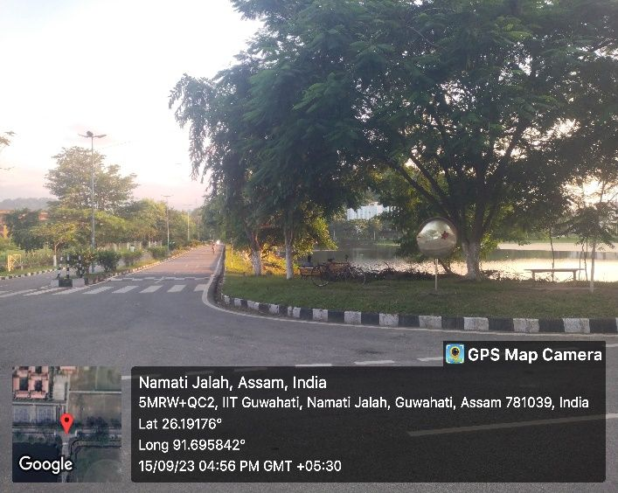
Location No.17
Observation – Mirror is totally damaged, nothing is visible. Orientation of the mirror is also disturbed. And the traffic is high on this intersection. No sign was there for intersection.
Risk – High
Priority – Essential
Suggestions – Mirror should be placed correctly and it should be fulfilling its purpose.

Slide 20
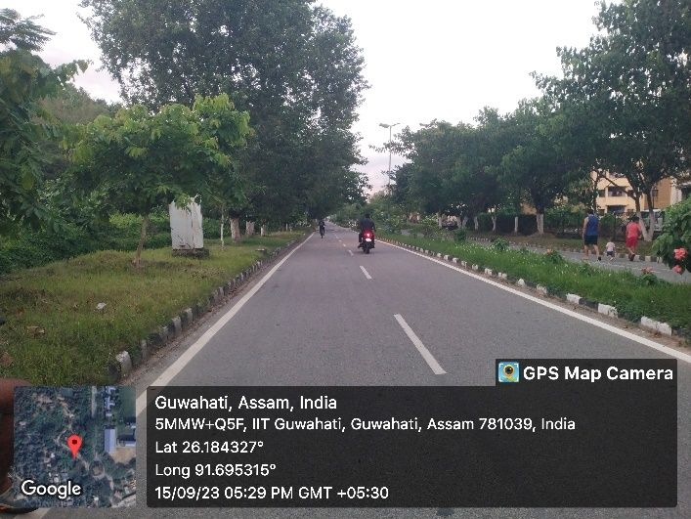
Location No.18
Observation – Vehicles are going with vey high speed.
Risk – High
Priority – Essential
Suggestions – Speed limit should be there.

Slide 21
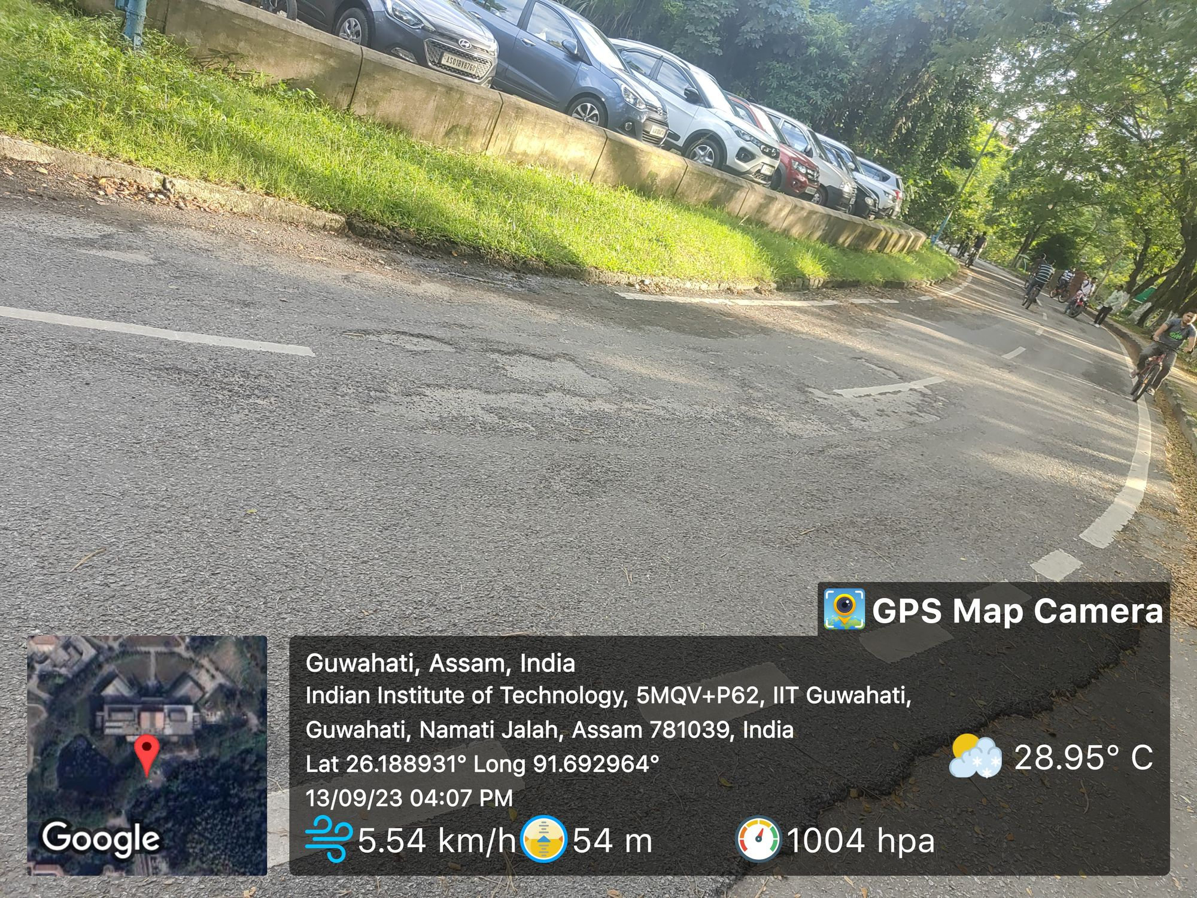
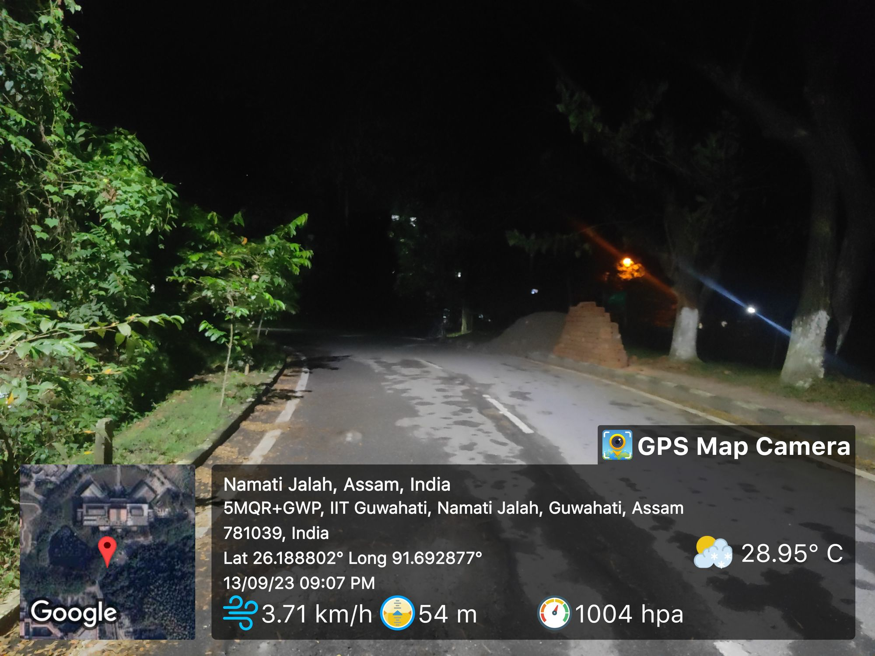
Location No.19
Observation – Some Patches which causes discomfort because they come on the sharp curve so driver can’t see it in a mean time.
Risk – Medium
Priority – Essential
Suggestions – Fix those patches as soon as possible .

Slide 22
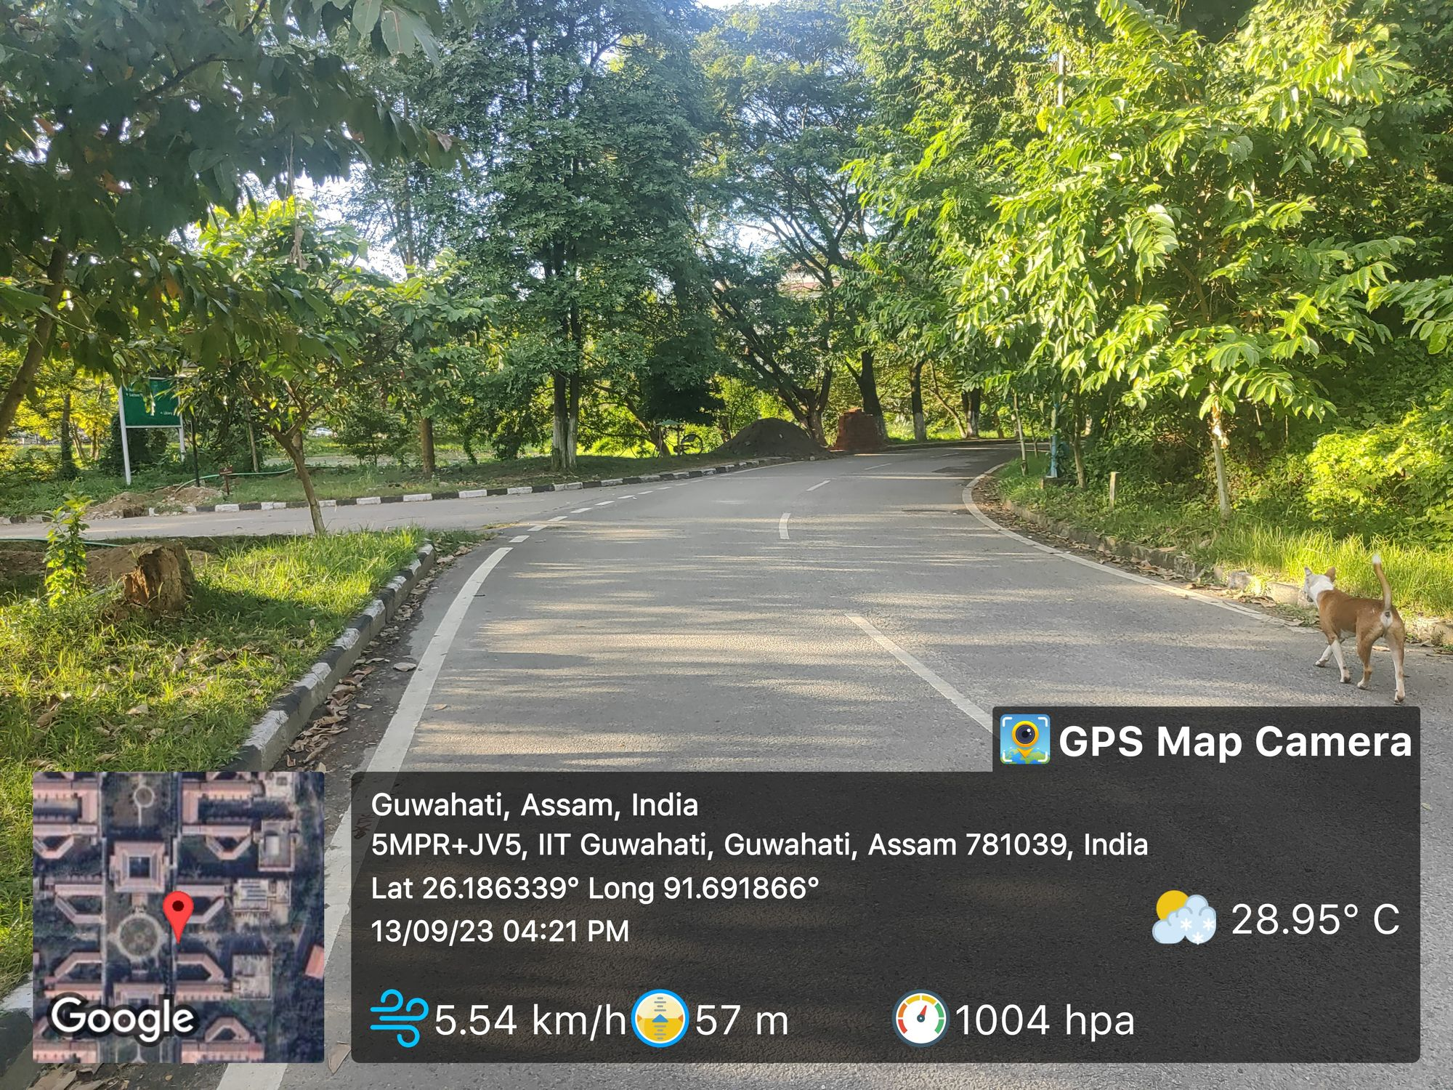
Location No.20
Observation – No sign is provided for the merging of road.
Risk – High
Priority – Highly Essential
Suggestions – Put a sign board of road merging.

Slide 23
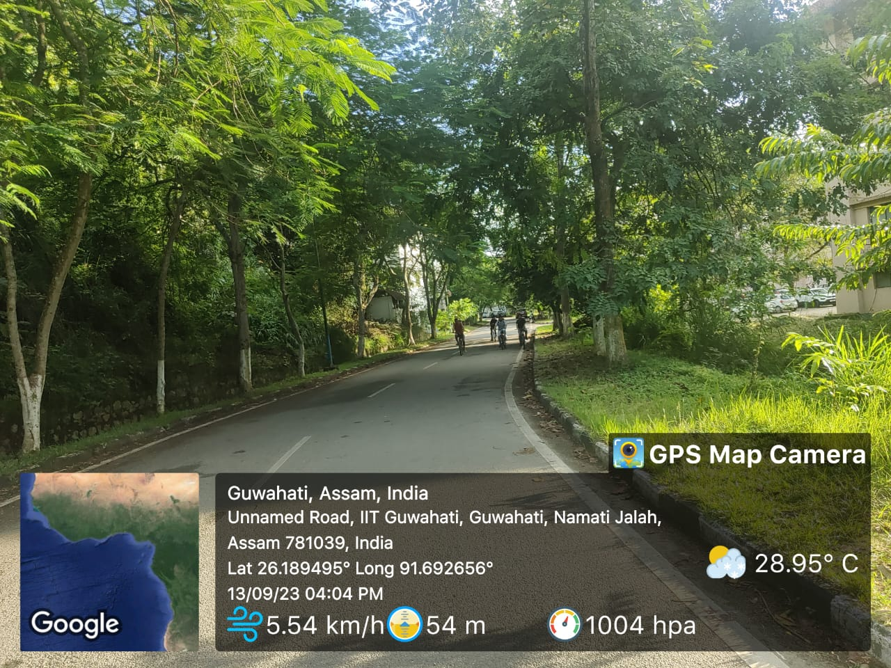
Location No.21
Observation – There is no sign about the T-Junction ahead after the sharp curve
Risk – High
Priority – Highly Essential
Suggestions – Put a sign board before the curve.

Slide 24
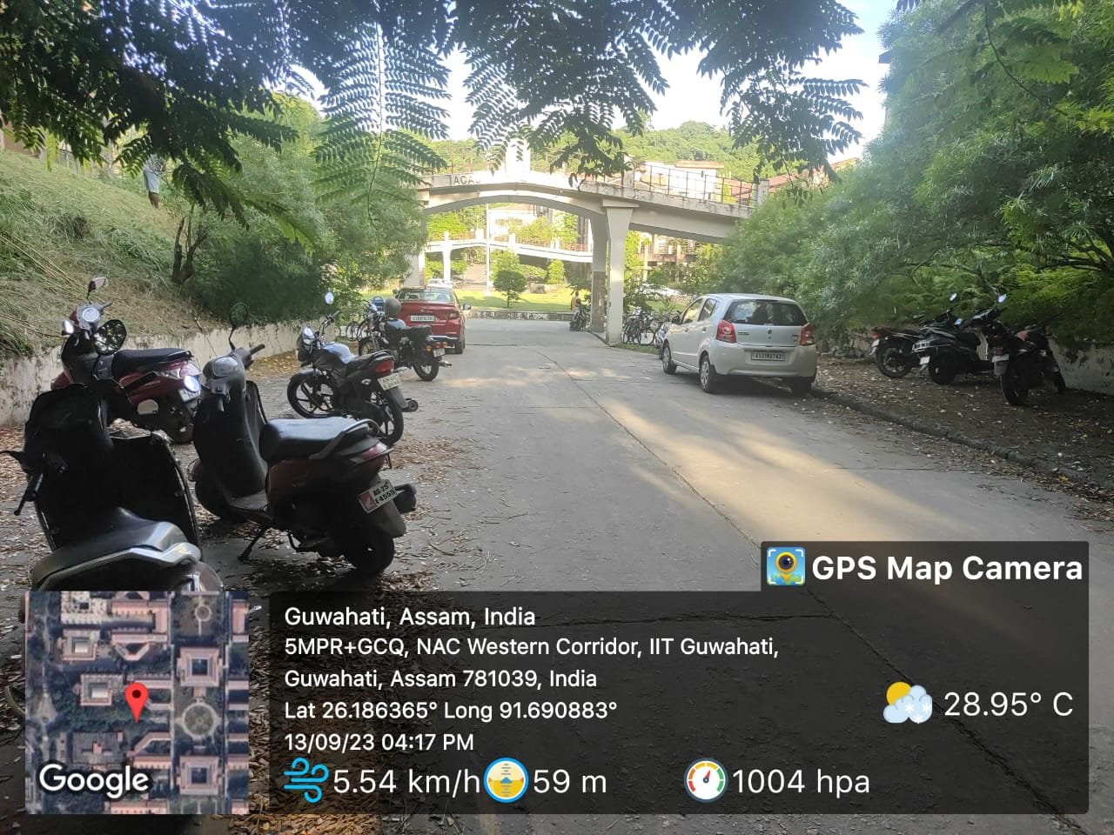
Location No.22
Observation – Speed breaker is present just after the steep downward slope and there are no sign board is present.
Risk – High
Priority – Essential
Suggestions – Provide the sign board .

Slide 25
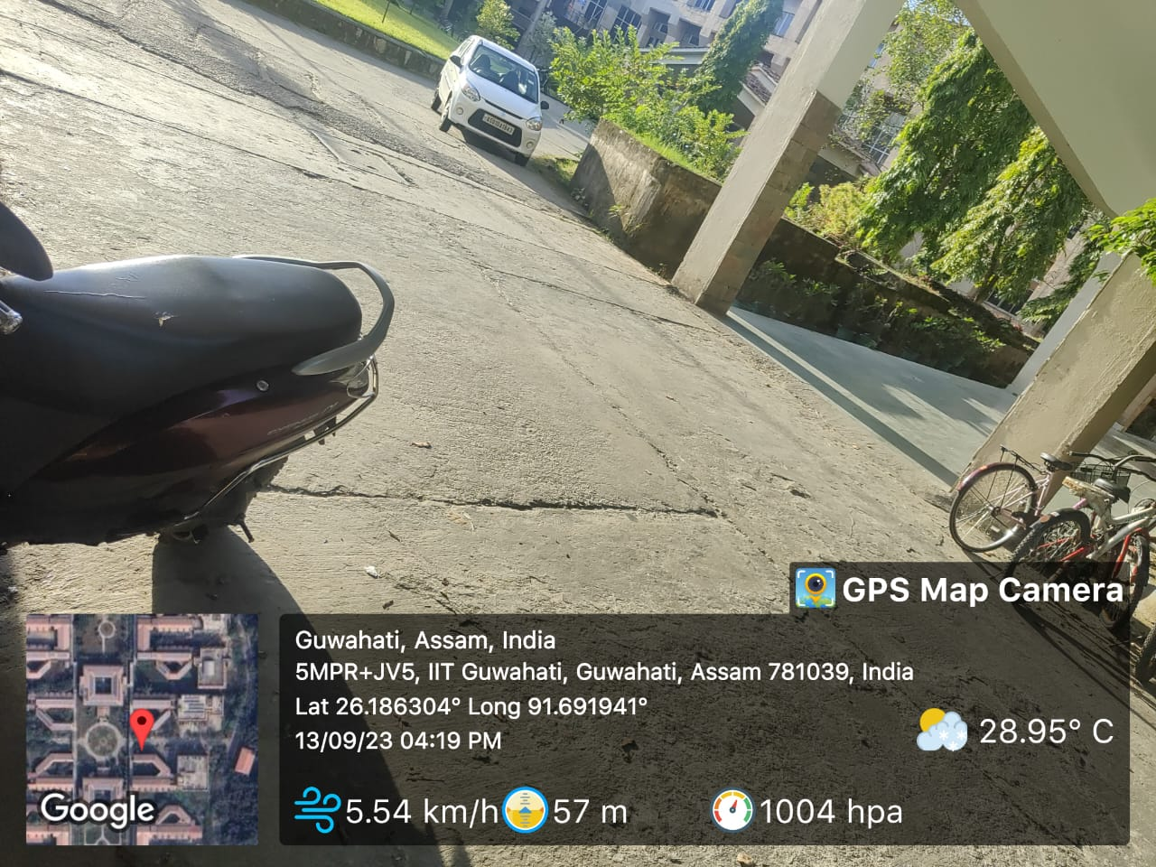
Location No.23
Observation – No crossing marking for pedestrian.
Risk – Less
Priority – Essential
Suggestions – Make crossing marking for pedestrian so driver knows about that this region is for pedestrian then they can slow down their vehicle.

Slide 26
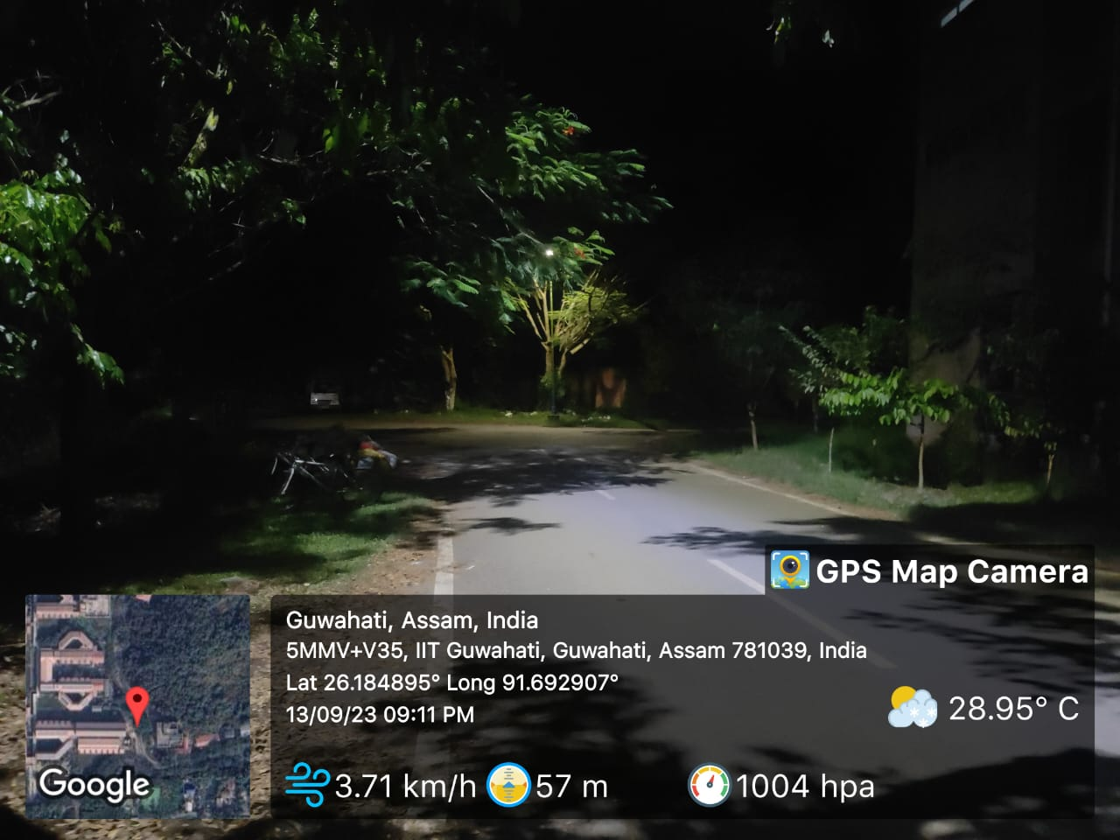
Location No.24
Observation – T Junction is there but there is no sign board or any light is present where driver can detect about the junction.
Risk – Very High
Priority – Highly Essential
Suggestions – Provide the sign board , street lights.

Slide 27
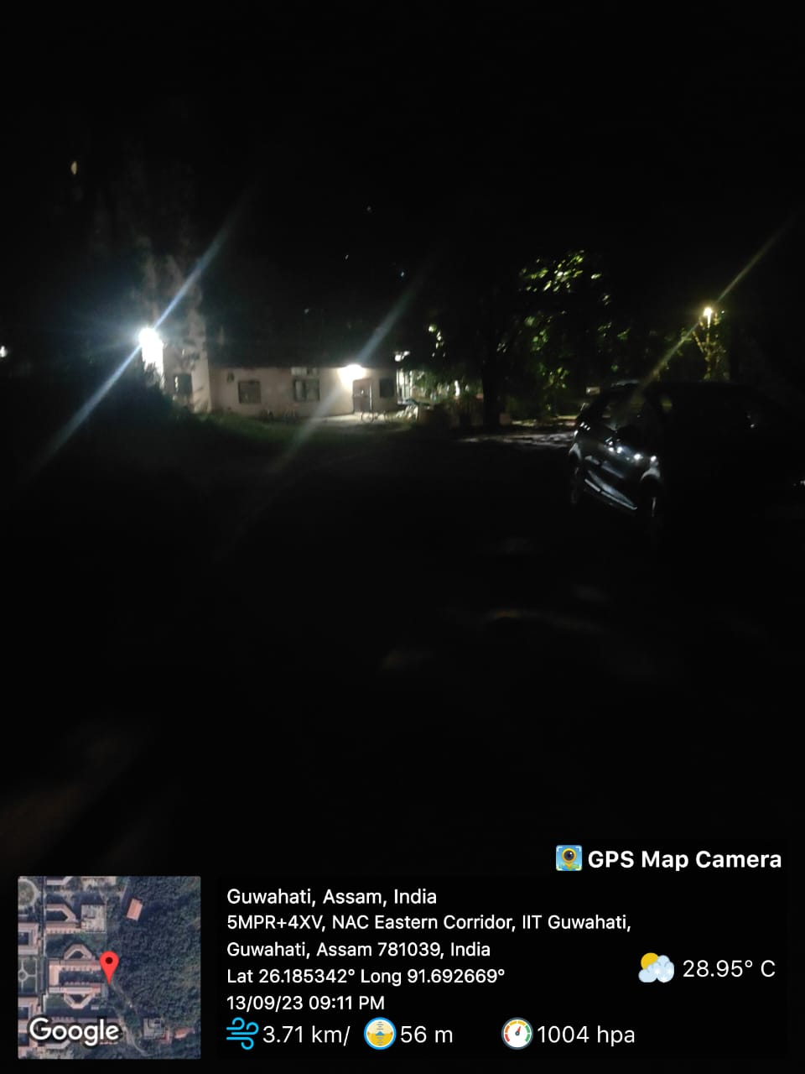
Location No.25
Observation – No light is present on the sharp curve or any kind of delineators.
Risk – Very High
Priority – Highly Essential
Suggestions – Provide the delineators and the streets lights and sign board also.

Slide 28
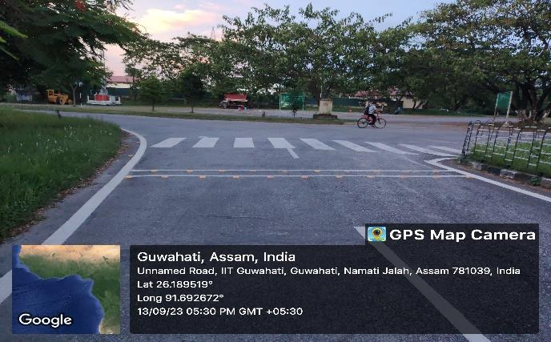
Location No.26
Observation – There is no any speed breaker. No sign for t intersection.
Risk – High
Priority – Highly Essential
Suggestions – Provide sign of t intersection and speed breaker on minor road.

Slide 29
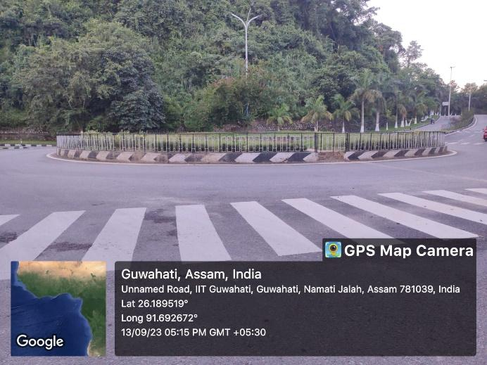
Location No.27
Observation – There is no delineator which helps in night time.
Risk – High
Priority – Highly Essential
Suggestions – Provide delineator along the island.

Slide 30
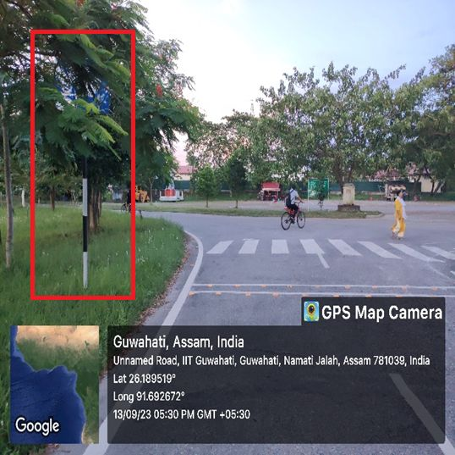
Location No.28
Observation – Sign board is not visible due to tree.
Risk – Medium
Priority – Highly Essential
Suggestions – Over the time interval we have to trim the trees.

Slide 31
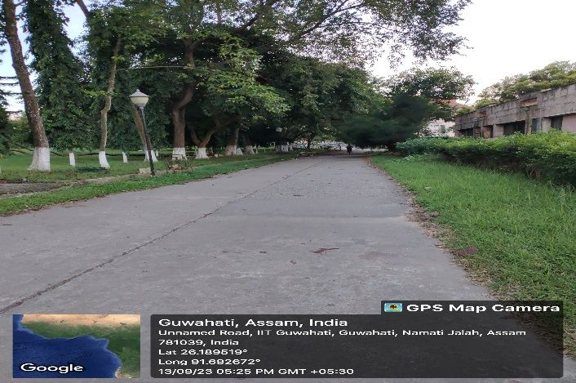
Location No.29
Observation – No road marking is available. Tress came over the road.
Risk – Very High
Priority – Highly Essential
Suggestions – Trim the trees and marking on road.

Slide 32
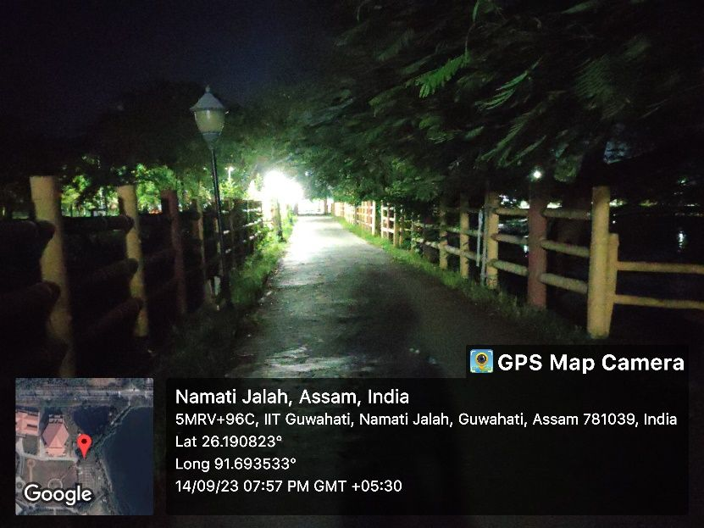
Location No.30
Observation – Low hanging branches of trees covers the road which causes the hinderance to visibility for pedestrian and cyclists.
Risk – High
Priority – Essential
Suggestions – Trim the low hanging branches of tress.

Slide 33
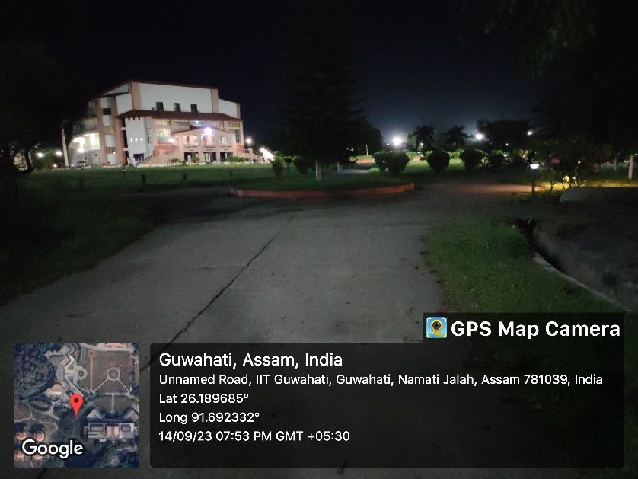
Location No.31
Observation – No proper lighting. No marking on road and chevron sign. Mirror is not there.
Risk – Very High
Priority – Highly Essential
Suggestions – Mark the road, placed mirror, provide chevron sign, provide light.

Slide 34
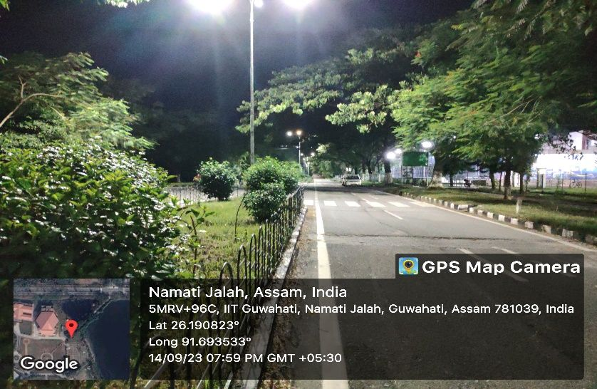
Location No.32
Observation – No sign of t intersection. No speed limit sign on t intersection.
Risk – Very High
Priority – Highly Essential
Suggestions – Provide speed limit sign and t intersection sign board.

